Slide 1
Observation: ethnographic fieldwork
Week 7

Slide 2
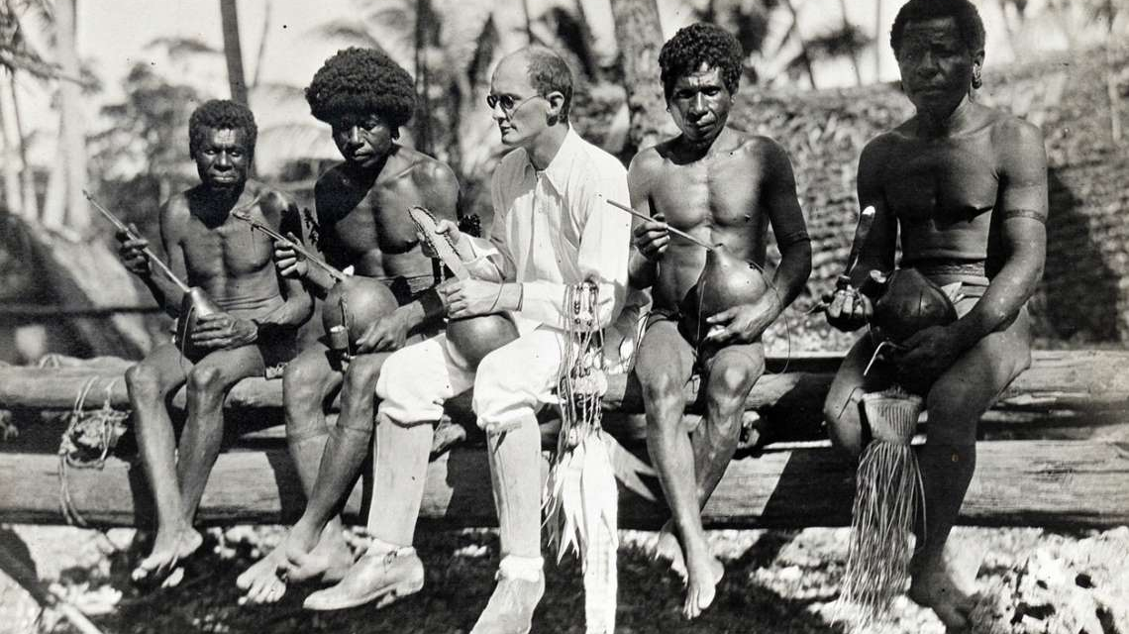
ethnography (n.)
From the Greek ethnos; people, nation, class, caste, tribe; a number of people accustomed to live together.
From Greek -graphia; “description of”; from graphein “to write, express by written characters”, earlier “to draw, represent by lines drawn”, “to scrape, scratch" (on clay tablets with a stylus)
Notes:
Close, in-depth study of a particular culture, how and why it operates as it does, what influences it, and the ways that culture interacts with and affects other cultures.
The act of doing this and the type of research produced from doing it
For a great long time researchers (primarily anthropologists) thought the best way to study ethnographically would be to study cultures that are foreign to them, ones that they are not a part of.
The belief was that studying a group from the outside (the etic approach) allowed the researcher the critical distance to properly observe a culture. They thought it granted them a kind of ‘social objectivity’ that allowed them to see what those inside the culture would miss or overlook because it had become too routine or pedestrian.
While there is merit to this approach, it also sought to maintain that cultural distance with the group it was studying. This meant that while much was observed about the group or culture, it was processed through an outside and biased lens.
It also meant that cultural knowledges that were too complex to be easily observed or interpreted by outside observers (even those who looked closely) were either misinterpreted or overlooked.

Slide 3
ethnography (n.)
‘Ethnography is . . . that part of anthropology (in the English sense of the word, the whole science of man) . . . which deals with the “cultures” of human groups.’
Robert H. Lowie, 1937
‘The objective of ethnography is to describe the lives of people other than ourselves, with an accuracy and sensitivity honed by detailed observation and prolonged first-hand experience.’
Tim Ingold, 2007
‘Ethnography is a method of data collection that involves spending an extensive period in the field and conducting prolonged observations and interviews with the subjects of the research. Time in the field helps building trust, access difficult-to-obtain data and observe variation.’
Federico Varese, 2022
Ethnography as a collection of “diverse ways of thinking and writing about culture”
James Clifford, 1988
Notes:
Some obvious limitations in these definitions; but they capture the essence
Ethnography as a loose general description of a method of data collection in various social sciences through (relatively participant) observation; Done by sociologists, cultural studies scholars, science studies specialists, management and marketing researchers, students in education schools, political scientists
And as a more specific approach within the discipline of anthropology
Anthropology has traditionally distinguished itself from sociology through (1) the emphasis placed on participant observation and fieldwork, and (2) studying chiefly non-industrialised societies. Sociology has concentrated on understanding, criticising and managing modern societies, whereas the historical task of anthropology has been to account for the variations and similarities in human existence and, to some extent, to rescue disappearing peoples from oblivion by recording their way of life in writing.
Culture - as the focus/object of ethnography
Writing - as the essence of ethnography as a method; a specific type of ‘writing’ or description
For a vigorous rebuttal of the assertion that ethnography is inseparable from anthropology, see Ingold 2008. For Ingold, the essence of anthropological works is conceptualisation and theory

Slide 4
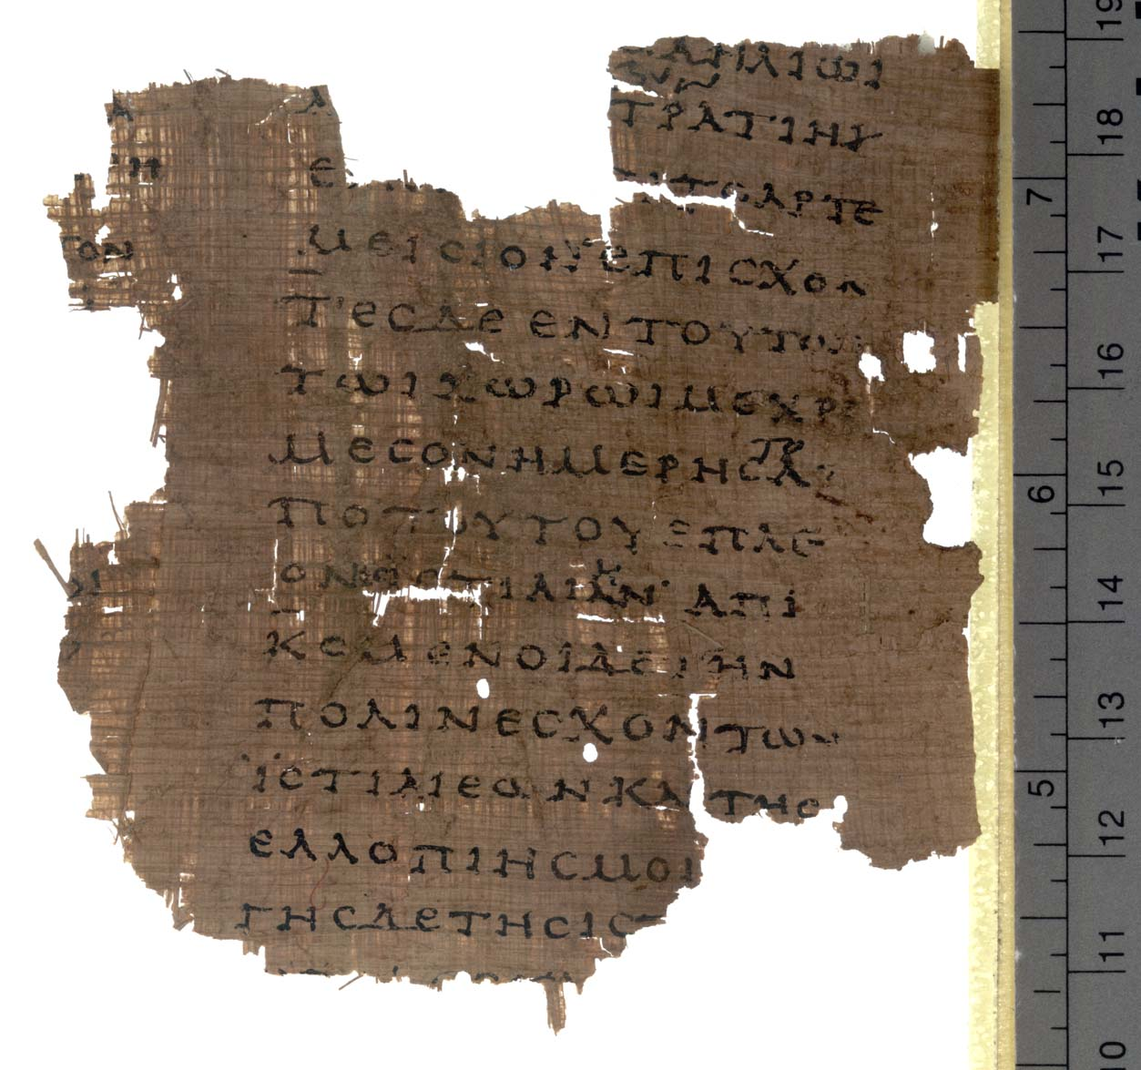
A brief (pre)history of ethnography
Arguably, the origins of ‘ethnography’ can be traced back to 6-5 BCE Greece (particularly, Herodotus’s Histories)
Developed in tandem with the wider sense of (Greek) identity, which had remained hazy and loosely organized until the 5th-century war with Persia whereupon it rapidly crystallized into a diametric opposition between “Hellene” and “barbarian”
“Invented” in response to the unprecedented levels of intercultural contact that accompanied Persian incursions into Ionia and mainland Greece
A historic link with imperialism
“Imagined” as a science in which the habits and customs of remote or exotic peoples are conscientiously documented by Europeans
Notes:
Which makes its origins as prestigious as those of philosophy and historiography; Herodotus Histories
Both ‘barbarian’ and ‘ethnography’ as invented
As we’ll see, what contemporary ethnography must grapple with is something similar: unprecedented levels of global cultural contact and diffusion
The historic link with imperialism means that modern conceptions of ethnography remain largely associated with the description of “primitive” peoples and colonial subjects
Ethnography is therefore “imagined” as a science in which the habits and customs of remote or exotic peoples are conscientiously documented by intrepid Europeans

Slide 5
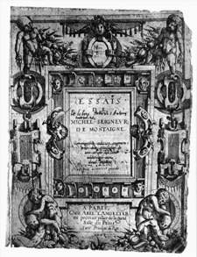
A brief (pre)history of ethnography
Michel de Montaigne’s Essays (~ 1570 to 1592)
Montaigne distrusts universal statements, and loves the exception, the particular case. We move from a general rule to an exception, then to an exception to the exception, until we seem to be left hanging.
He “himself” is also always present: rules, statements, observations undergo a sort of personal vetting. “As for me,” Montaigne will write, and what is right for himself, he readily concedes, is not necessarily right for anyone else (although it could be . . .). The Essays are definitely the recordings of the thoughts of a particular man living a particular life …
(from Langer 2005)
Notes:
Which makes its origins as prestigious as those of philosophy and historiography; Herodotus Histories
Both ‘barbarian’ and ‘ethnography’ as invented
As we’ll see, what contemporary ethnography must grapple with is something similar: unprecedented levels of global cultural contact and diffusion
The historic link with imperialism means that modern conceptions of ethnography remain largely associated with the description of “primitive” peoples and colonial subjects
Ethnography is therefore “imagined” as a science in which the habits and customs of remote or exotic peoples are conscientiously documented by intrepid Europeans

Slide 6
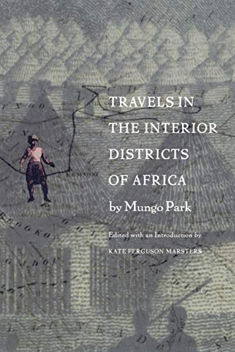
A brief (pre)history of ethnography
“We stopped a little at a village called Dangali; and in the evening arrived at Dalli. We saw upon the road two large herds of camels feeding. When the Moors turn their camels to feed, they tie up one of their fore legs, to prevent their straying. . . . The people were dancing before the Dooty's house. But when they were informed that a white man was come into the town, they left off dancing and came to the place where I lodged, walking in regular order, two and two, with the music before them. They play upon a sort of flute; but instead of blowing into a hole in the side, they blow obliquely over the end”
(Park, Travels in the Interior Districts of Africa, 1860 [1799]: 46)
Notes:
Which makes its origins as prestigious as those of philosophy and historiography; Herodotus Histories
Both ‘barbarian’ and ‘ethnography’ as invented
As we’ll see, what contemporary ethnography must grapple with is something similar: unprecedented levels of global cultural contact and diffusion
The historic link with imperialism means that modern conceptions of ethnography remain largely associated with the description of “primitive” peoples and colonial subjects
Ethnography is therefore “imagined” as a science in which the habits and customs of remote or exotic peoples are conscientiously documented by intrepid Europeans
By the early sixteenth century in Europe, it was conventional for travel accounts to consist o f a combination o f first-person narration, recounting one's trip, and description o f the flora and fauna of regions passed through and the manners and customs o f the inhabitants.

Slide 7
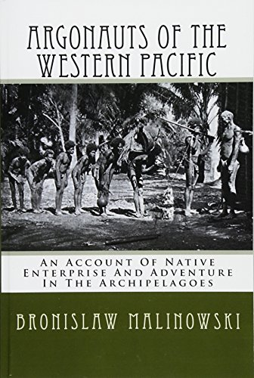
A brief (pre)history of ethnography
“The time when we could tolerate accounts presenting us the native as a distorted, childish caricature of a human being are gone … This picture is false, and like many other falsehoods, it has been killed by Science" (Malinowski, Argonauts of the Western Pacific 1922)
An ideal for ethnography (?): a neutral discourse that would render other realities “exactly as they are,” not filtered through our own values and interpretive schema
But is such a ‘scientific’ strategy limiting ethnography's ability to explain or examine itself as a kind of writing?

Slide 8
“Science” and/or personal narrative?
Personal narrative persists alongside objectifying description in ethnographic writing
Opening narratives commonly recount the writer's arrival at the held site, for instance, the initial reception by the inhabitants, the slow, agonizing process of learning the language and overcoming rejection, the anguish and loss at leaving
These play the crucial role of anchoring that description in the intense and authority-giving personal experience of fieldwork
The practice of combining personal narrative and objectified description has a long history in those kinds of writing from which ethnography has traditionally distinguished itself.
Notes:
Mungo Park's Travels in the Interior Districts of Africa (1799)
Raymond Firth’s We, the Tikopia (1936) introduces himself via the classic Polynesian arrival scene. T h i s scene became a commonplace in the literature of the South Sea explorations of Cook, Bougainville and others in the 1760s and 70s
Malinowski’s "brief outline of an Ethnographer’s tribulations" in the intro to Argonauts
Firth and Malinowski, then, both invoke well-established images from travel literature in their opening view o f the ethnographer

Slide 9
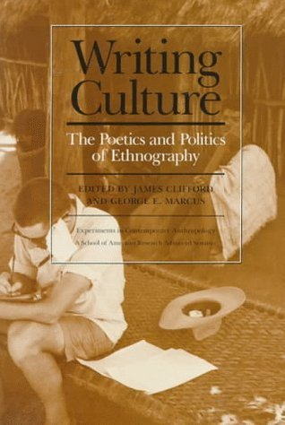
‘Writing’ culture
The classic ethnographic monograph from the 1920s to the 1950s typically dealt with a people’s most important institutions, aiming at a comprehensive overview of ‘the way of life’ of a people, describing the interrelationship between religion, politics, the economy, kinship and so on.
The ‘holistic’ study of social life: an understanding of the interrelationships between different aspects of culture and society
It is becoming less common today, but it is still a core element of ethnographic writing
Notes:
Still, the distinctiveness of ethnography lies in the minutiae of its recording of information and description of events
One obvious reason is that most anthropological studies now take place in complex large-scale settings and are not limited to villages
Another reason is the growing specialisation within the discipline, which has turned many professionals into highly specialised sub-disciplinary experts focusing, say, on medical systems, socialisation, public rituals or political rhetoric in particular societies
A third, related, reason is the fact that a wealth of general ethnography has already been carried out on most regions, so it is frequently unnecessary to begin from scratch

Slide 10
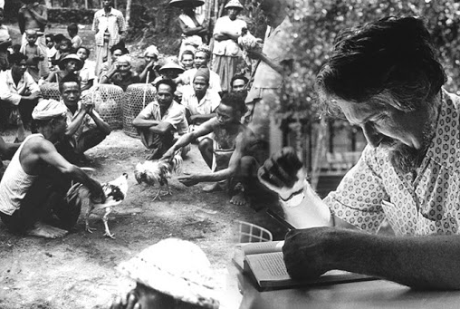
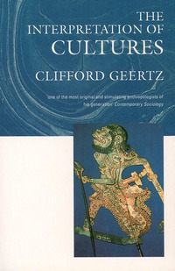
Clifford Geertz “Deep Play: Notes on the Balinese Cockfight”, pp. 412-455 in The Interpretation of Cultures, Basic Books, 1973.
Source: https://www.earthstoriez.com/traditional-tajen-cockfighting-bali/geertz/
(Available at YSJ)
Notes:
Gaining entry and writing about it

Slide 11
Geertz: deep play and thick description
The title of Clifford Geertz's essay "Deep Play: Notes on a Balinese
Cockfight," written about the time the film Deep Throat was all the rage, announces a series of erotic puns—puns, Geertz maintains, the Balinese themselves would understand—used throughout his essay
Puns are frequent in ethnography
Through the pun he appeals collusively to the members of one or the other world, usually the world of his readership, thereby creating a hierarchical relationship between them
He himself, the punster, mediates between these worlds

Slide 12
Geertz: deep play and thick description
Geertz's essay begins with a humorous tale of entry—by now, in its own right, a genre or subgenre of ethnography
The hero is cast stereotypically as an awkward simpleton, not at all sure of his identity, often suffering from some sort of exotic malady, who is caught in a betwixt and between worlds
“Early in April of 1958, my wife and I arrived, malarial and diffident, in a Balinese village we intended, as anthropologists, to study. A small place, about five hundred people, and relatively remote, it was its own world. We were intruders, professional ones, and the villagers dealt with us as Balinese seem always to deal with people not part of their life who yet press themselves upon them: as though we were not there. For them, and to a degree for ourselves, we were nonpersons, specters, invisible men” (1973: 412)
Notes:
Here in the first paragraph of "Deep Play," Geertz establishes an opposition between himself and his wife and the Balinese who live in their own remote little world.

Slide 13
Geertz: deep play and thick description
Geertz claims dramatically that he and his wife were "nonpersons, specters, invisible men" for the villagers and "to a degree for ourselves"—that is, until like the other villagers attending the cockfight, they fled the police. Then they were recognized
“The indifference, of course, was studied; the villagers were watching every move we made, and they had an enormous amount of quite accurate information about who we were and what we were going to be doing. But they acted as if we simply did not exist, which, in fact, as this behavior was designed to inform us, we did not, or anyway not yet” (412 —13)

Slide 14
Geertz: deep play and thick description
“In the cockfight man and beast, good and evil, ego and id, the creative power of aroused masculinity and the destructive power of loosened animality fuse in a bloody drama of hatred, cruelty, violence, and death. It is little wonder that when, as is the invariable rule, the owner of the winning cock takes the carcass of the loser—often torn limb from limb by its enraged owner—home to eat, he does so with a mixture of social embarrassment, moral satisfaction, aesthetic disgust, and cannibal joy” (430—21)
But on what grounds does he attribute "social embarrassment,“ "moral satisfaction," "aesthetic disgust" (whatever that means), and “joy" to the Balinese?

Slide 15
Geertz: deep play and thick description
The cockfight “catches up these themes—death, masculinity, rage, pride, loss, beneficence, change—and ordering them into an encompassing structure, presents them in such a way as to throw into relief a particular view of their essential nature. It puts a construction on them, makes them, to those historically positioned to appreciate the construction, meaningful—visible, tangible, graspable—"real“ in an ideational sense. An image, fiction, a model, a metaphor, the cockfight is a means of expression; its function is neither to assuage social passions nor to heighten them (though, in its playing-with-fire way it does a bit of both), but, in a medium of feathers, blood, crowds, and money, to display them.” (443-444)
Notes:
He offers no proof anywhere that
the cockfight is so marked for his Balinese. Piling image on image—
"image," "fiction," and "metaphor"—may assuage Geertz's own theoretical
anxiety, but it hardly gets rid of the problem. (Image, fiction,
model, and metaphor are of course no more equivalent than nonperson,
specter, and invisible man.) Cockfights are surely cockfights
for the Balinese—and not images, fictions, models, and metaphors.

Slide 16
Geertz: deep play and thick description
For Geertz, the cockfight itself becomes a grand metaphor for Balinese social organization
Despite Geertz's ostensible concern for the understanding of the native’s point of view, his essay is less a disquisition on Balinese cockfighting, subjectively or objectively understood, than on interpreting—reading—cultural data.
His analysis is exemplary, and this exemplary quality, Geertz's interpretive virtuosity, helps render it ethnographically convincing
Its ultimate significance is not moral but methodological

Slide 17
The Universal and the Particular
Striking a balance between similarities and differences
Universality versus (Cultural) Relativism: to what extent do all humans, cultures or societies have something in common, and to what extent is each of them unique?
Comparative concepts (supposedly culturally neutral terms) like kinship system, gender role, system of inheritance, etc., implicitly acknowledge that human societies have several features in common
Donald Brown’s Human Universals (1991) claims that anthropologists have for generations exaggerated the differences between societies, neglecting the very substantial commonalities that hold humanity together
Notes:
Theoretical questions have often revolved around the issue of universality versus relativism
Brow’s critique is directly directed at Geertz

Slide 18
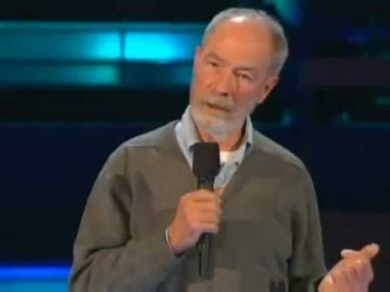

Donald E. Brown Human Universals (1991)
Notes:
https://www.youtube.com/watch?v=HNJSQAL0sEo
Video 2.5 minutes long

Slide 19
Here and There
Locating the ‘field’

Slide 20
The field
A ‘field science’
A field study may last for a few months, a year, or even two years or more, and it aims to develop as intimate an understanding as possible of the phenomena investigated
It is generally agreed that the anthropologist ought to stay in the field long enough for their presence to be considered more or less ‘natural’ by the permanent residents, the informants, although they will always to some extent remain strangers
Becoming a ‘doubly marginal’ person, in a sense suspended between one’s own society and the society under investigation (Evans-Pritchard (1983 [1937], 243)
Notes:
Fieldwork and the idea of the ’field’ is central to ethnographic practice

Slide 21
Preparing for fieldwork
Evans-Pritchard (1983) recalled the advice he was given before setting out for fieldwork in the early 1920s:
“Don’t converse with an informant for more than twenty minutes because if you aren’t bored by that time, he will be” (Westermarck)
“One should always behave as a gentleman” (Haddon)
“Take ten grams of quinine every night and to keep off women” (Seligman)
“Not to be a bloody fool” (Malinowski)
Evans-Pritchard: ‘one must know precisely what one wants to know’ and then fashion a suitable methodology from the available techniques
But is that possible/desirable?
Notes:
E-P 1983 [1937]. Witchcraft, Magic and Oracles among the Azande, ed. Eva Gillies. Oxford: Oxford University Press
First, he asked the famous Finnish ethnologist Westermarck …
Similar (updated) advice in the late 2000s – 2005-2010 undergraduate years
Evans-Pritchard himself emphasises, later in the same account, that facts are themselves meaningless; in other words, ‘one must know precisely what one wants to know’ and then fashion a suitable methodology from the available techniques
But there is a very good reason why ethnographic fieldwork is so loosely conceived and taught: ‘what one wants to know’ often becomes apparent only after one has begun fieldwork, which shows why proper fieldwork takes a long time. There is – alas – no simple recipe for fieldwork.

Slide 22
Fieldwork methods
Fieldwork combines a series of formal techniques and unstructured participant observation
Participant observation refers to the informal field methods which form the basis for most fieldwork, whether or not it is supplemented with other techniques
Contemporary urban fieldwork tends to be more discontinuous and often depends on more formal methods, such as the semi-structured interview or archival work

Slide 23
Changes of the ‘field’
New challenges because of historical changes in the world
It has become impossible to posit sharp distinctions between ‘us’ (moderns) and ‘them’ (primitives), ‘home’ and ‘abroad’
Analyses of traditional societies have inspired researchers to use similar analytical models when dealing with their own society, and have also provided a useful basis for comparison
There is a methodological and theoretical continuity, therefore, between studies of small-scale traditional societies and studies in contemporary cities
Notes:
a number of new challenges because of historical changes in the world, including the dramatic transformation of ‘the tribal world’ and the forces of globalisation – from the Internet to migration

Slide 24
Multi-sited ethnography
Multi-sited research is designed around chains, paths, threads, conjunctions, or juxtapositions of locations in which the ethnographer establishes some form of literal, physical presence, with an explicit, posited logic of association or connection among sites that in fact defines the argument of the ethnography
The object of multi-sited ethnography is defined through several practices of construction through movement and of tracing within different settings of a complex cultural phenomenon

Slide 25
Global fieldwork?
But should we now take ‘the globe’ or ‘global society’ as our unit of study?
How can one even pretend to know such an object through ethnographic means?
Do we need a new kind of object to take the place of ‘culture’ and ‘society’—not just a bigger version of the same, but an object that would capture within itself the social and spatial relations that traverse our old, spatially defined objects?
Or should we move away from the notion of an ‘object of study’ altogether?
Notes:
James Ferguson in Coleman and Hellermann
Marcus (3): Ethnography in/of the World System

Slide 26
Small Places, Large Issues
Anthropology and ethnographic theory “asks large questions, while at the same time it draws its most important insights from small places”
(Thomas Hylland Eriksen, 1995)

Slide 27

A recipe for ethnographic theory
Godfrey Lienhardt (1985), borrowing an analogy from Geertz, has compared the relationship between theory and ethnography to an elephant-and-rabbit stew:
What is required is one elephant of ethnography and one rabbit of theory.
The art consists in cooking the stew in such a way that the taste of rabbit is discernible in every spoonful

Slide 28
A personal journey

Slide 29
The rabbit and the elephant in practice

Slide 30
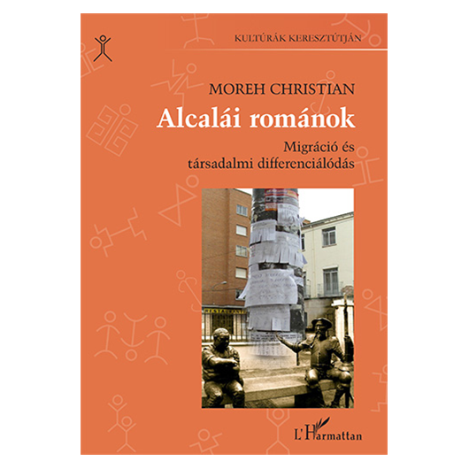

Slide 31
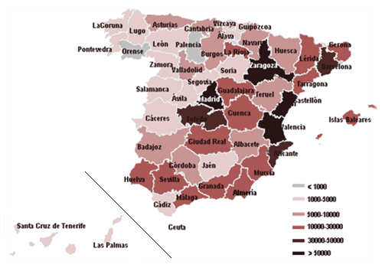
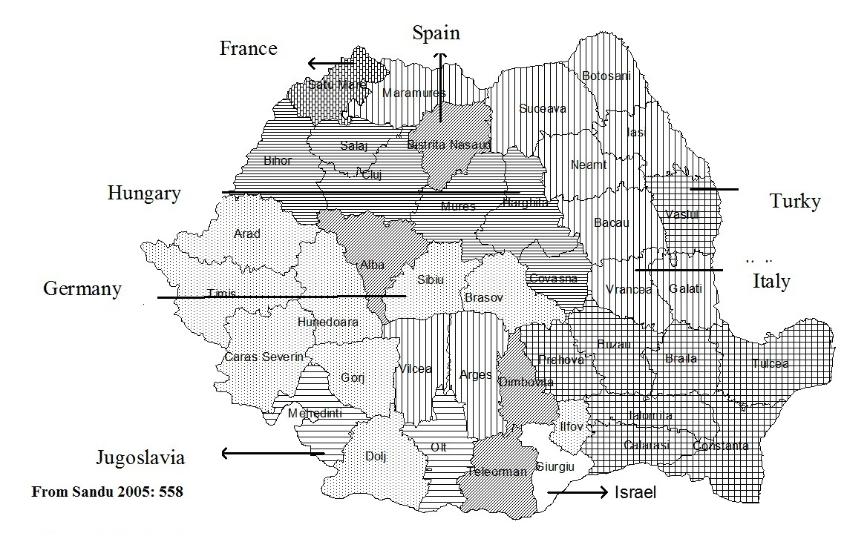
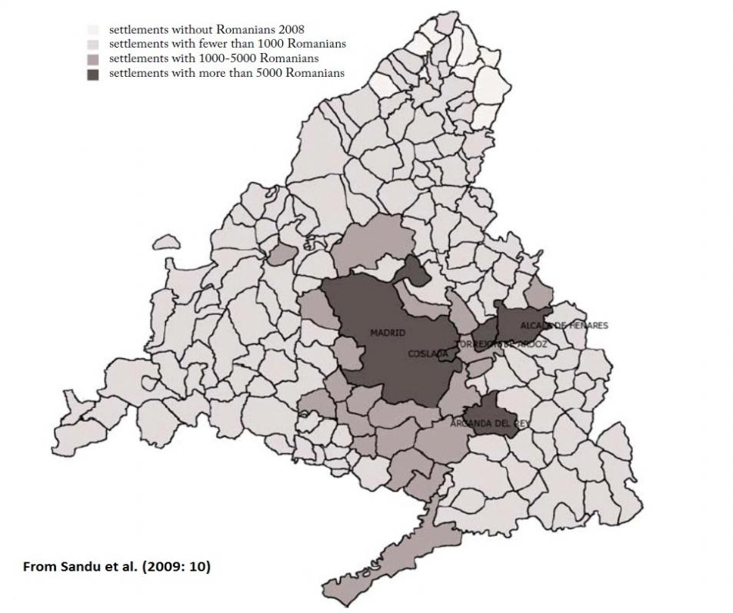
‘We all knew one another, and we were from the same place. We have been helped when we arrived, and it was our duty to help others. We knew we could trust them, because they had nowhere to go, and our families back home knew their relatives’ (Grigore, 49).
1989-1995
‘pioneers’
1995-2002
Schengen visa requirements
Chains
2002-2007
Post-Schengen
Massification
2007-
EU Accession
Ethnographic fieldwork in Alcalá de Henares
March -July 2009, two years after Romania’s EU accession and couple of months after Spain had suspended labour market restrictions for Romanian citizens. The fieldwork location was selected for its size and ethnic composition. Being a medium-sized town (about 200 thousand inhabitants) with a significant but not dominant Romanian population (10 per cent), it allowed for the observation of both differentiation and community formation practices.
34 life-story interviews, informal talks, observation.
Notes:
Sandu, Dumitru ed. (2009) Romanian Communities in Spain. Bucharest: Soros Foundation Romania
Sandu Dumitru (2005) Emerging transnational migration from Romanian villages. Current Sociology, vol 53 (4), pp. 555-582.

Slide 32
A model of social differentiation of Romanians in Alcalá de Henares
Economic and occupational |  | Profile | Status
Internal | Low capital: ‘flat-chiefship’, informal subcontracting | In-group | Improvement
 | High capital: transportation companies, grocery shops | In-group | Improvement
 | Small businesses, self-employment | Mixed | Improvement
External | White-collar work at local branches of Romanian companies | Mixed | Recovery
 | White-collar work at Spanish companies | Out-group | Recovery
 | State sponsored associations, foundations, NGOs | In-group | Recovery
 | Spanish diploma, professional qualification | Out-group | Improvement
Political and associational |  | Profile | Status
Internal | Leaders of associations, community leaders | In-group | Improvement
 | Local Romanian political parties | In-group | Improvement
External | Local branches of Romanian parties | In-group | Improvement
 | Local Spanish political parties | Mixed | Improvement
Prestige and cultural |  | Profile | Status
Internal | Voluntary teachers | In-group | Recovery
 | Artistic activities | In-group | Recovery Improvement
 | Attempt to establish local parishes by migrant associations; appointing excommunicated priests | In-group | Recovery
External | Parishes can only be established by the Orthodox church, and priests must be canonized in Romania | In-group | Retention
 | ‘Romanian Language and Culture’ teachers | In-group | Recovery
 | Journalists, Romanian media workers (Spanish and Romanian initiatives) | In-group | Recovery Improvement
Many people are trashing that woman… They say she took advantage of us. I used to calm them down because many had been living on her money until they could find work… But they all forget about that. Of course, she had a profit from their rents, but she also helped a lot; one should take all this into consideration (Alex, 40)
My aunt, just so you know, when she walks about in the village [in Romania] everyone greets her and she is much respected. She had brought many people to Spain; she helped them immensely, and not for money, like others did. No, no, she told everyone openly that she can bring them here, offer a place to stay, help with the papers, but it is their responsibility to find work and get on their feet, and their salary also belongs to them. She only helped with what she could, but she did that altruistically (Matei, 34)

Slide 33
A model of social differentiation of Romanians in Alcalá de Henares
Economic and occupational |  | Profile | Status
Internal | Low capital: ‘flat-chiefship’, informal subcontracting | In-group | Improvement
 | High capital: transportation companies, grocery shops | In-group | Improvement
 | Small businesses, self-employment | Mixed | Improvement
External | White-collar work at local branches of Romanian companies | Mixed | Recovery
 | White-collar work at Spanish companies | Out-group | Recovery
 | State sponsored associations, foundations, NGOs | In-group | Recovery
 | Spanish diploma, professional qualification | Out-group | Improvement
Political and associational |  | Profile | Status
Internal | Leaders of associations, community leaders | In-group | Improvement
 | Local Romanian political parties | In-group | Improvement
External | Local branches of Romanian parties | In-group | Improvement
 | Local Spanish political parties | Mixed | Improvement
Prestige and cultural |  | Profile | Status
Internal | Voluntary teachers | In-group | Recovery
 | Artistic activities | In-group | Recovery Improvement
 | Attempt to establish local parishes by migrant associations; appointing excommunicated priests | In-group | Recovery
External | Parishes can only be established by the Orthodox church, and priests must be canonized in Romania | In-group | Retention
 | ‘Romanian Language and Culture’ teachers | In-group | Recovery
 | Journalists, Romanian media workers (Spanish and Romanian initiatives) | In-group | Recovery Improvement
‘Yes, I am satisfied, because in Romania I would have never achieved what I have achieved here. You can rest assured that I could have spent ten lives working in Romania without such results’ (Teodor, 52)
‘I think [it was easier to set up a business in Spain] … Both because of the available bank loans and the straightforward bureaucracy. But be it wherever, it all depends on your personal ambition, hard work, and the way you treat people’ (Sanda, 39)

Slide 34
A model of social differentiation of Romanians in Alcalá de Henares
Economic and occupational |  | Profile | Status
Internal | Low capital: ‘flat-chiefship’, informal subcontracting | In-group | Improvement
 | High capital: transportation companies, grocery shops | In-group | Improvement
 | Small businesses, self-employment | Mixed | Improvement
External | White-collar work at local branches of Romanian companies | Mixed | Recovery
 | White-collar work at Spanish companies | Out-group | Recovery
 | State sponsored associations, foundations, NGOs | In-group | Recovery
 | Spanish diploma, professional qualification | Out-group | Improvement
Political and associational |  | Profile | Status
Internal | Leaders of associations, community leaders | In-group | Improvement
 | Local Romanian political parties | In-group | Improvement
External | Local branches of Romanian parties | In-group | Improvement
 | Local Spanish political parties | Mixed | Improvement
Prestige and cultural |  | Profile | Status
Internal | Voluntary teachers | In-group | Recovery
 | Artistic activities | In-group | Recovery Improvement
 | Attempt to establish local parishes by migrant associations; appointing excommunicated priests | In-group | Recovery
External | Parishes can only be established by the Orthodox church, and priests must be canonized in Romania | In-group | Retention
 | ‘Romanian Language and Culture’ teachers | In-group | Recovery
 | Journalists, Romanian media workers (Spanish and Romanian initiatives) | In-group | Recovery Improvement
While most associations were established to promote the solution of a concrete issue, they had the ability to affect status relations more widely. The oldest Romanian association in Alcalá dates back to 1999, having lived its active heyday in 2003-2004 while its political links with the city council were closest
The Romanian Saturday school, the folk ensemble, and the literary circle initiated by the association have also provided former teachers and artists the opportunity to recover some of their previous social statuses by doing voluntary work specific to their qualifications and knowledge.
‘Being a writer used to be a noble title [in our society]’ Vintilă Horia (1979: 266)

Slide 35
A model of social differentiation of Romanians in Alcalá de Henares
Economic and occupational |  | Profile | Status
Internal | Low capital: ‘flat-chiefship’, informal subcontracting | In-group | Improvement
 | High capital: transportation companies, grocery shops | In-group | Improvement
 | Small businesses, self-employment | Mixed | Improvement
External | White-collar work at local branches of Romanian companies | Mixed | Recovery
 | White-collar work at Spanish companies | Out-group | Recovery
 | State sponsored associations, foundations, NGOs | In-group | Recovery
 | Spanish diploma, professional qualification | Out-group | Improvement
Political and associational |  | Profile | Status
Internal | Leaders of associations, community leaders | In-group | Improvement
 | Local Romanian political parties | In-group | Improvement
External | Local branches of Romanian parties | In-group | Improvement
 | Local Spanish political parties | Mixed | Improvement
Prestige and cultural |  | Profile | Status
Internal | Voluntary teachers | In-group | Recovery
 | Artistic activities | In-group | Recovery Improvement
 | Attempt to establish local parishes by migrant associations; appointing excommunicated priests | In-group | Recovery
External | Parishes can only be established by the Orthodox church, and priests must be canonized in Romania | In-group | Retention
 | ‘Romanian Language and Culture’ teachers | In-group | Recovery
 | Journalists, Romanian media workers (Spanish and Romanian initiatives) | In-group | Recovery Improvement
the Spanish and Italian votes’ had decided the outcome of the 2009 Romanian presidential elections (Zidărescu 2009)
Strategies adopted in the religious field have failed.
The ex-priest who had unsuccessfully attempted to recover his status as a clergyman, has since entered politics as a local representative of the then ruling Romanian party.
Newly arrived priests are spared the struggle for status recognition, being able to retain their original social prestige.
We cannot talk about a ‘normal’ Romanian language press in Spain due to ‘the lack of community feeling and cooperation’. When ‘people will realise they belong here, and that their children are no longer immigrants but Spanish, European and Romanian at once, then there shall be real press and real journalists’ (Camil, 55, journalist)

Slide 36
A model of social differentiation of Romanians in Alcalá de Henares
Economic and occupational |  | Profile | Status
Internal | Low capital: ‘flat-chiefship’, informal subcontracting | In-group | Improvement
 | High capital: transportation companies, grocery shops | In-group | Improvement
 | Small businesses, self-employment | Mixed | Improvement
External | White-collar work at local branches of Romanian companies | Mixed | Recovery
 | White-collar work at Spanish companies | Out-group | Recovery
 | State sponsored associations, foundations, NGOs | In-group | Recovery
 | Spanish diploma, professional qualification | Out-group | Improvement
Political and associational |  | Profile | Status
Internal | Leaders of associations, community leaders | In-group | Improvement
 | Local Romanian political parties | In-group | Improvement
External | Local branches of Romanian parties | In-group | Improvement
 | Local Spanish political parties | Mixed | Improvement
Prestige and cultural |  | Profile | Status
Internal | Voluntary teachers | In-group | Recovery
 | Artistic activities | In-group | Recovery Improvement
 | Attempt to establish local parishes by migrant associations; appointing excommunicated priests | In-group | Recovery
External | Parishes can only be established by the Orthodox church, and priests must be canonized in Romania | In-group | Retention
 | ‘Romanian Language and Culture’ teachers | In-group | Recovery
 | Journalists, Romanian media workers (Spanish and Romanian initiatives) | In-group | Recovery Improvement
I did not choose the bank because they paid more. In fact, I used to earn better while working as a cook. (…) At the casino, I used to work from five in the afternoon until three in the morning, including weekends and holidays, while at the bank I work eight hours a day on weekdays. … After I had decided to remain here for a longer period, my aim was to develop my career and lead a more normal life’ (Magdalena, 30).
Establishing small businesses with a mixed customer profile – like running a pub or an internet-café – are other strategies of entering the Spanish formal socio-economic hierarchy. Self-employment is also associated a higher social status (cf. Serdedakis et al. 2003; Wahlbeck 2008). What attaches social prestige within the migrant community to these occupational positions, is that they represent success stories, models to follow in the advancement towards an ideal ‘normal’ life similar to that of the non-migrant population.

Slide 37
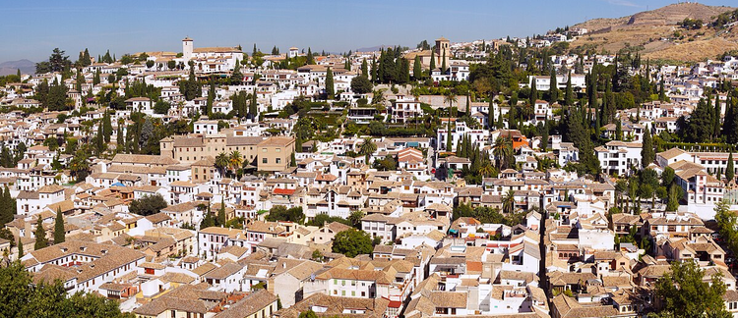

Slide 38
